Slide 1









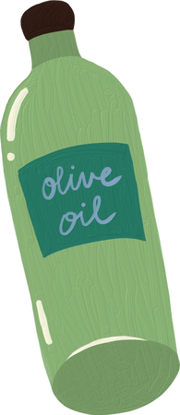
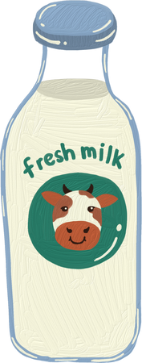

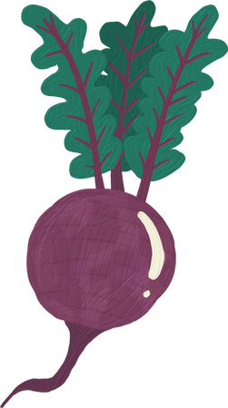
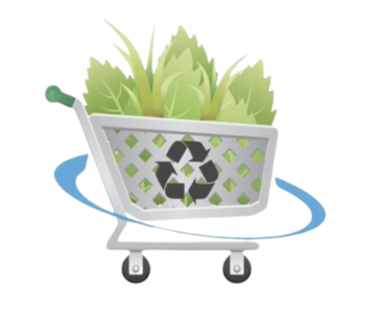


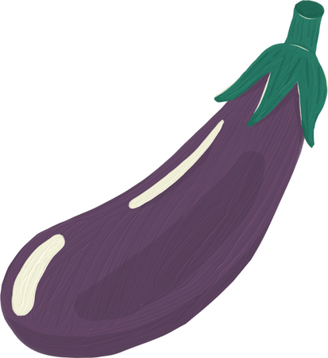


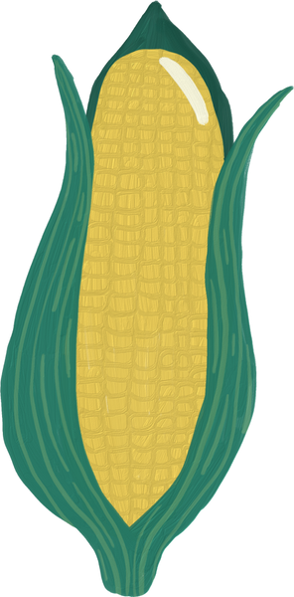

GREEN
MARKET
Presentation by
Group 3

Slide 2


TODAY'S AGENDA
Problem Statement
Solution [prototype]
Business model
Feasibility & costumer test
Impact on society
Conclusion

Slide 3

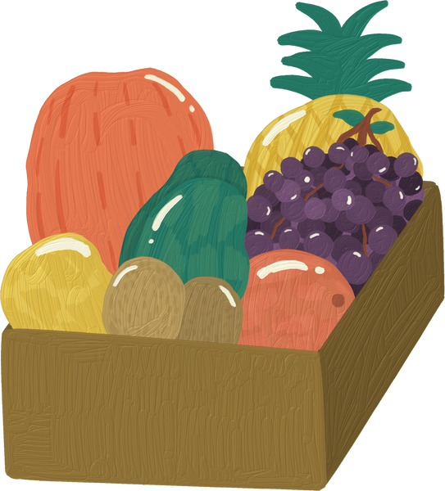
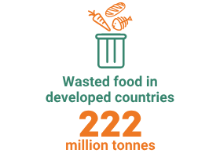
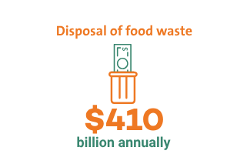
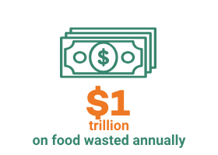
PROBLEM STATEMENT:
Disposing of food waste can be an expensive task for such a seemingly simple thing to do. It can be converted to useful substances such as fertilizer or biofuel, but many people and businesses don’t dispose of it properly. Wasting lots of food like this is costly, but also providing the means to discard the waste is a difficult chore. That is why lots of people don’t go through the difficult processes currently available to get rid of the excess food.

Slide 4


SOLUTION:
Green market ‘
First step towards sustainability and effective resource management.
A web application aims to bridge the gap by connecting food providers with excess or near-expiry items to farms, biogas facilities, and fertilizer firms.
Food waste diverted from landfills, used for energy production or improving soil fertility due to better communication and transactions.
Strategy converts trash to resources, reducing food waste and promoting circular economy ideas.
Join us to discover how Green Market is revolutionizing resource management and helping achieve sustainability goals.

Slide 5
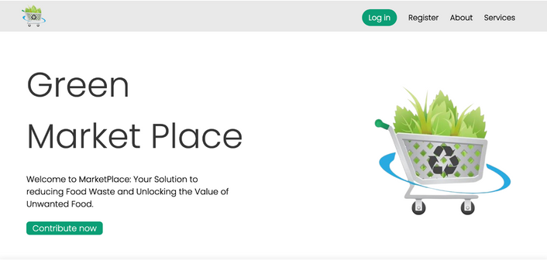
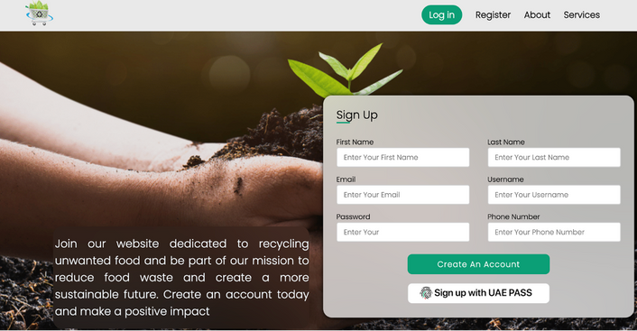
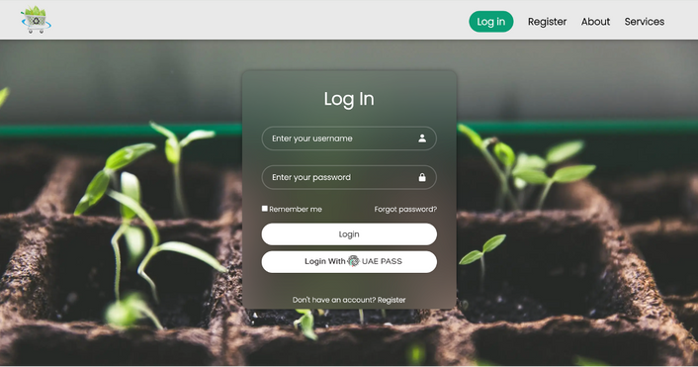
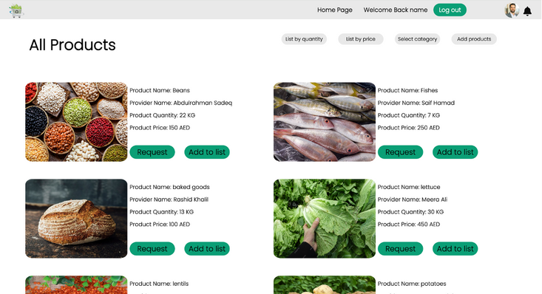
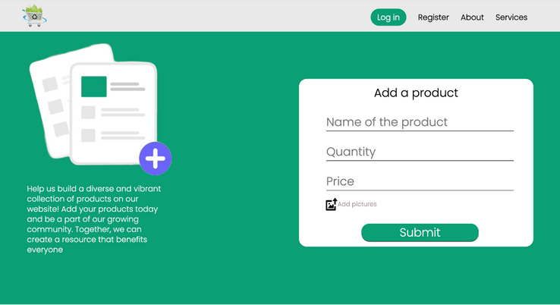
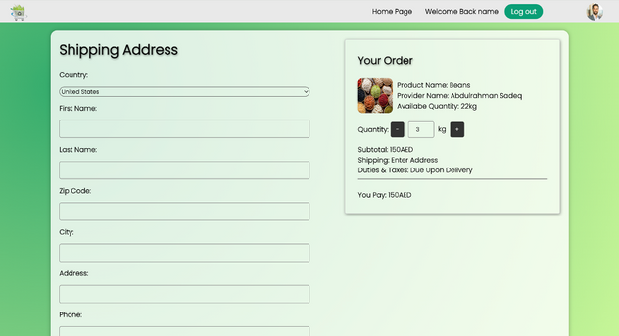
#LANDING PAGE #REGISTRATION PAGE #LOGIN PAGE
#RECYCLE PRODUCTS PAGE #ADD PRODUCT PAGE #CHECK OUT PAGE
A small demonstration of our web application
Demonstration video

Slide 6


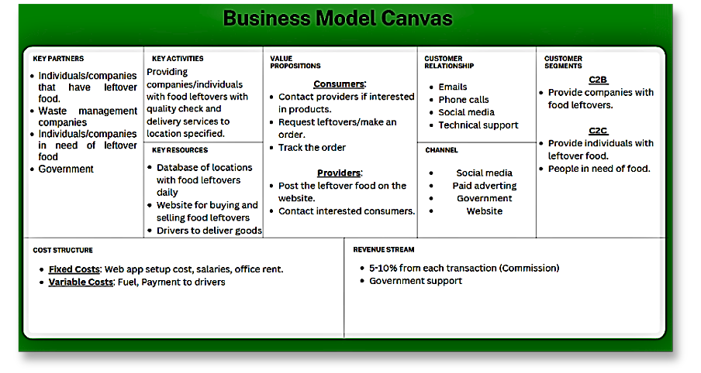
BUSINESS MODEL CANVAS
As an intermediary business we provide a service and take a commission from each transaction 5-10% from each transaction.

Slide 7


FEASIBILITY AND CUSTOMER TEST:
market channel and feedback
Positive: The use of UAEPASS was perfect to consume time
FACE-TO-FACE CHANNEL
Negative: none
Positive: Smooth access, easy to use, adding the finance part was new information to me.
WHATSAPP CHANNEL
Negative: It is better to use Products pictures instead of putting the same picture for all products.
Positive: Interesting problem/solution, loved the design and colors of advert
INSTAGRAM CHANNEL
Negative: none

Slide 8


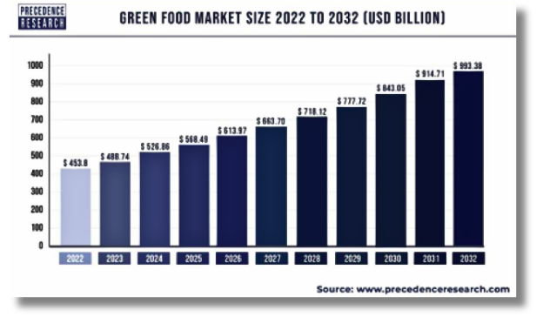


MARKET ANALYSIS:
Based on the graph depicting the average green market size, it is evident that the sector is poised for significant growth.
With a projected Compound Annual Growth Rate of 7.45% from 2022 to 2032, the global green market is expected to expand substantially.
In the UAE, EroeGo emerges as a prominent competitor, offering fresh products nearing expiration at discounted rates through its online grocery network.
This initiative aims to combat food waste by providing consumers with cost-effective options while reducing surplus inventory.

Slide 9







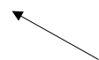
BULLEYES MARKETING:
After we made sure that our website will use, we try to contact people from the different platforms to get their feedback about our solution we used 3 channels.
1. Face to face
WHATSAPP CHANNEL
2. WhatsApp
3. Instagram
INSTAGRAM CHANNEL
FACE TO FACE CHANNEL

Slide 10




CONCLUSION
In conclusion, "Green Market" has a profound impact. Economically, it reduces disposal costs and supports sustainable businesses. Socially, it fosters community engagement through donations, promoting solidarity. Environmentally, it minimizes food waste and conserves resources. Overall, it embodies the potential of technology to drive positive change across economic, social, and environmental spheres.
THANK
YOU

